Slide 1
Overview of Genomics Data Generation
Fred W. Kolling IV, PhD
Co-Director, Genomics Shared Resource
December 14th, 2020

Slide 2
Genetics vs Genomics: What’s the difference?
Genetics: the study of one or a few genes and their patterns of inheritance
Gregor Mendel’s pea experiments
Pedigree analysis of familial disease
Genomics: The study of all genetic material within an organism
Only made possible in last 20 years
High throughput sequencing
Computational biology

Slide 3
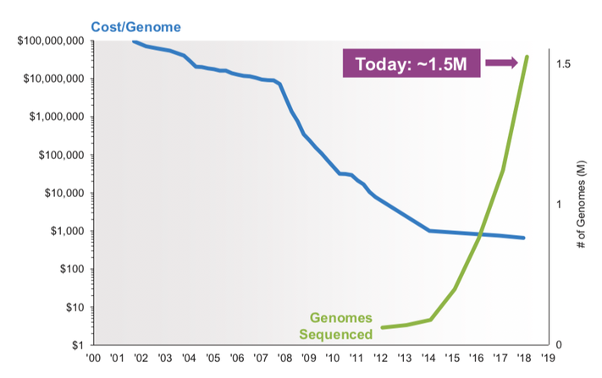
Next Generation Sequencing reduces costs, expands access to genomics technologies

Slide 4

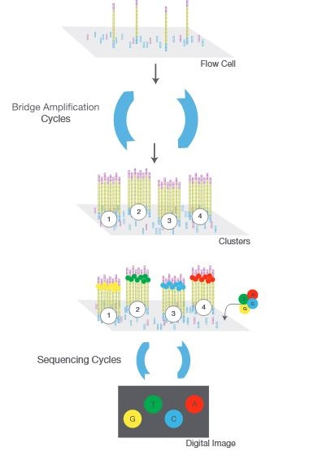
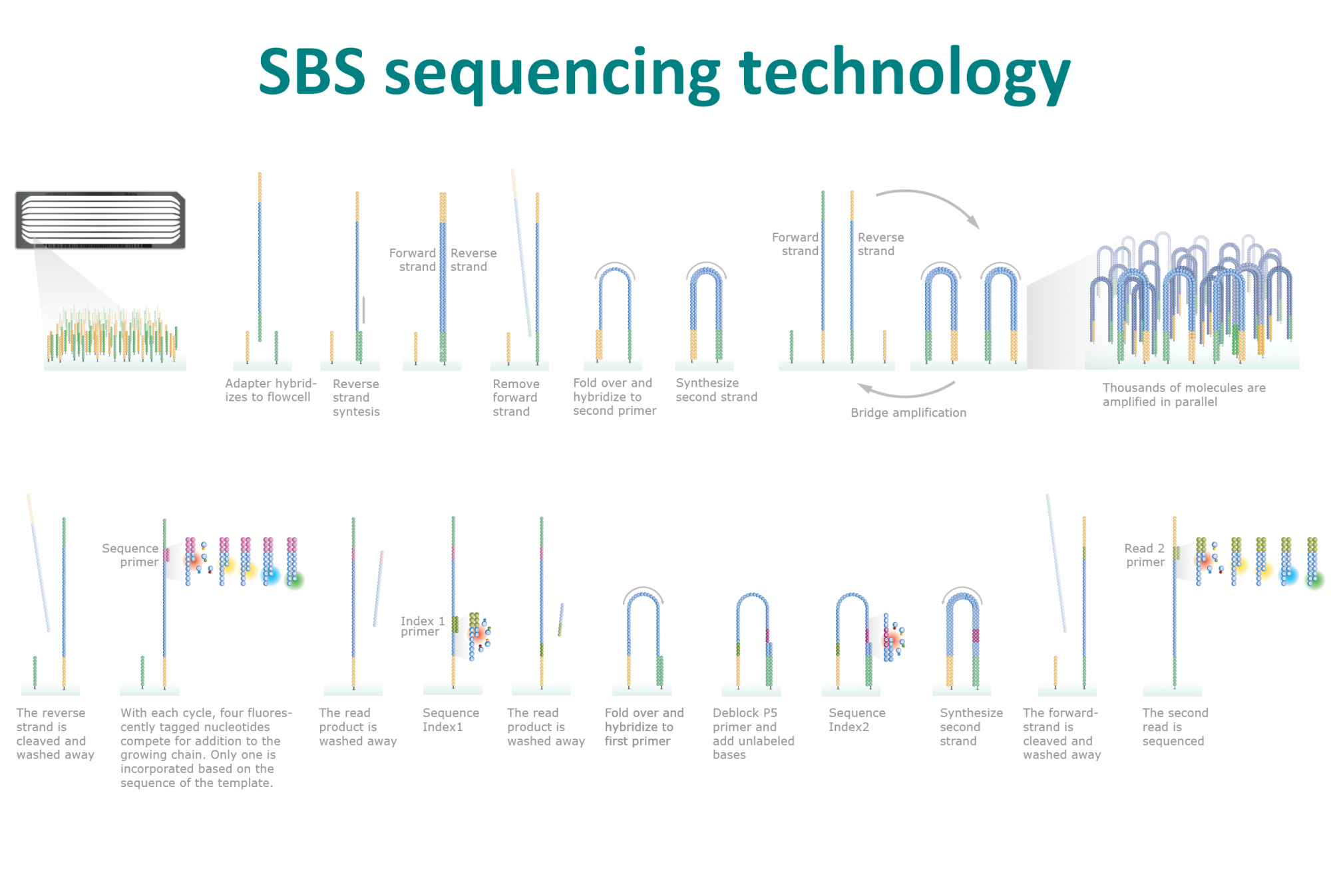
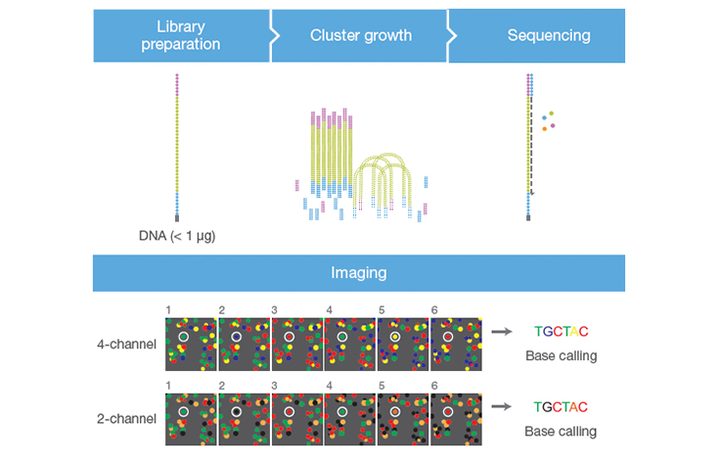
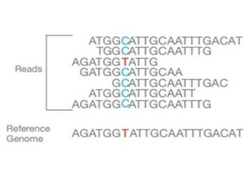
What is Next Generation Sequencing (NGS)?
Sequencing by Synthesis (SBS) Technology

Slide 5
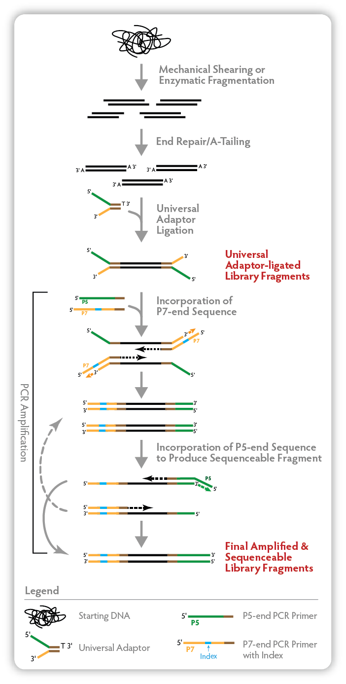
Preparing DNA for NGS
DNA must be made into a “library” prior to sequencing
Add sequences required for binding to flow cell, priming sites for sequencing

Slide 6
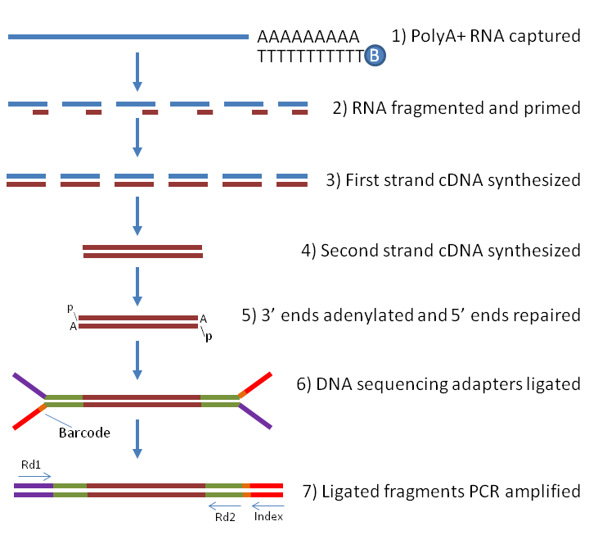

Preparing RNA for NGS
Ribodepletion
rRNA accounts for ~95% of RNAs in the cell
Not interesting and must remove before sequencing
PolyA Capture
Only captures PolyA RNA (mRNA)
Requires high quality samples (RIN>7)
Captures all RNAs >200nt (ncRNAs + mRNAs)
Good for low quality samples

Slide 7
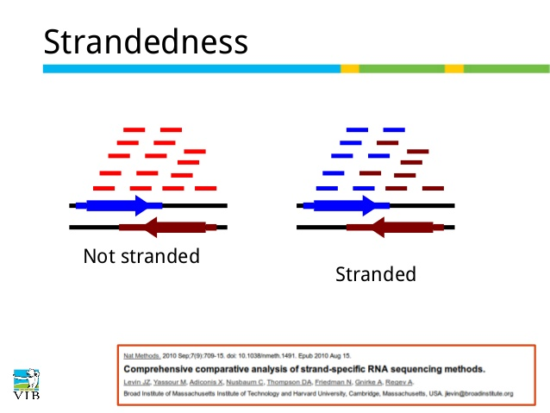
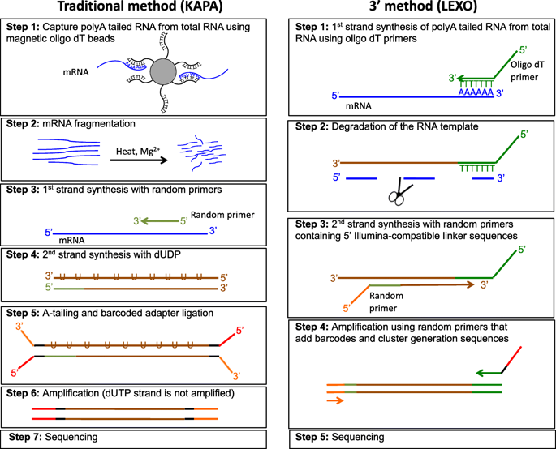
Preparing RNA for NGS
RNA must first be converted into cDNA, then prepared the same as DNA libraries
Stranded libraries are essential for identifying overlapping genes, especially antisense transcripts

Slide 8
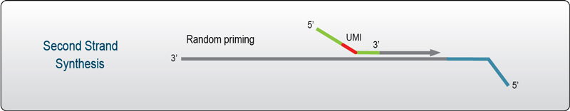
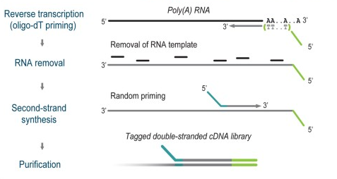
Modifications to traditional RNA-seq methods
Unique Molecular Identifiers (UMIs) to improve quantification
Gene A
Gene B
3’-end sequencing to reduce costs for differential expression

Slide 9
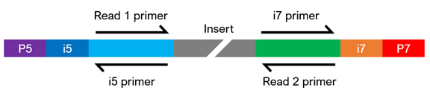
Reading libraries on the sequencer
Inserts can be read in one (single-end) or both (paired-end) directions
Libraries may contain “index” sequences that are unique to each sample, allowing multiplexing on the same run
Index
Index

Slide 10
Data output from the sequencer: bcl and fastq files
Basecall files (bcl)
Contains raw data regarding fluorescence color and intensity at each cluster for each sequencing cycle
Convert to fastq →bcl2fastq
Fastq
Nucleotide sequences
Basecall quality scores in PHRED format
Sequencer information
Example fastq entry
Phred Quality Score | Probability of incorrect base call | Base call accuracy
10 | 1 in 10 | 90%
20 | 1 in 100 | 99%
30 | 1 in 1000 | 99.9%
40 | 1 in 10,000 | 99.99%
50 | 1 in 100,000 | 99.999%
60 | 1 in 1,000,000 | 99.9999%

Slide 11
Data access and storage
Data files are large!
Files are stored on DartFS
High speed, redundant disk space
Accessible via Discovery/Polaris
Can be mounted to your PC/Mac
Each lab has a folder that is protected with your NetID and password
We can add/remove people from your lab group
Data can also be shared via a web link for external users
Fastqs are stored for 5 years in read-only format
Run Type | Size (Gb)
MiniSeq Mid Output 300 cycle | 5Gb
MiniSeq High Output 300 cycle | 14Gb
NextSeq Mid Output 300 cycle | 30Gb
NextSeq High Output 300 cycle | 100Gb
Storage Speed | Time
High Speed (T3) | 1yr
Archive (T4) | 4yrs

Slide 12
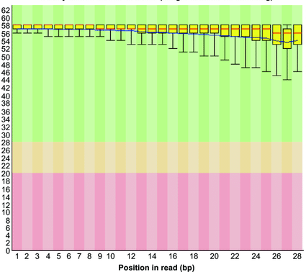
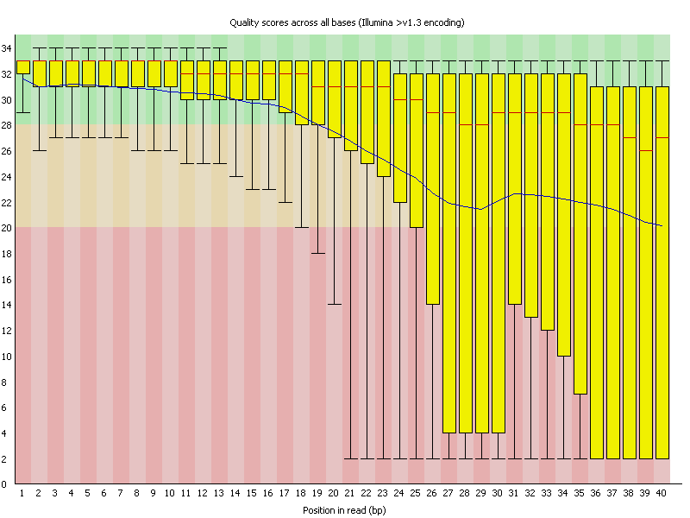
Data output from the sequencer: bcl and fastq files
Basecall files (bcl)
Contains raw data regarding fluorescence color and intensity at each sequencing cycle
Convert to fastq →bcl2fastq
Fastq
Nucleotide sequences
Basecall quality scores in PHRED format
Sequencer information
Good Quality
Poor Quality

Slide 13
Preprocessing reads for downstream analysis
Remove adapter sequences from resulting from read through
Remove Poly-A/T sequences from RNA-seq data
Quality trimming to remove low quality bases
Parsing UMIs if present
Index
Index

Slide 14
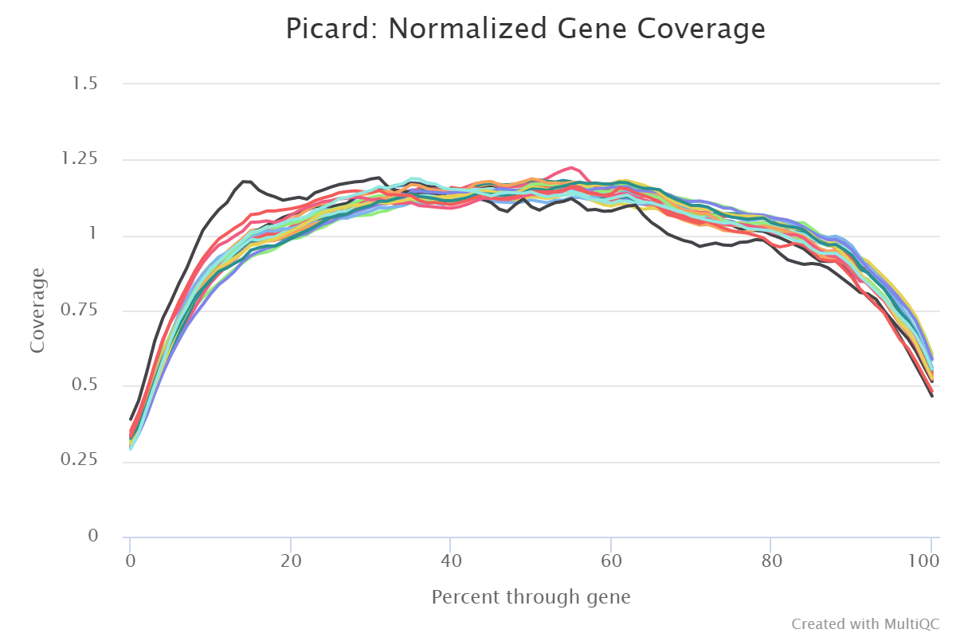
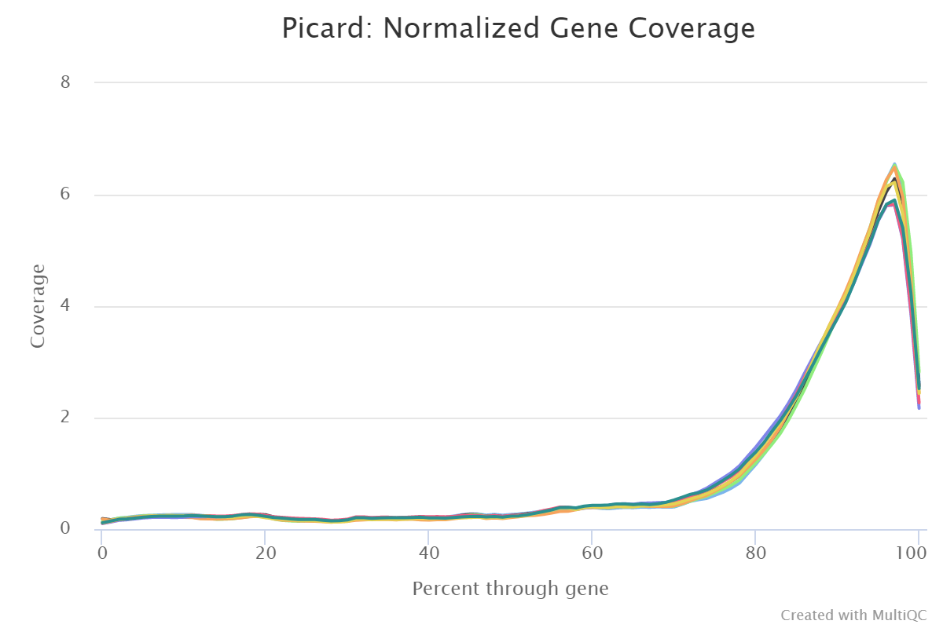
Evaluating coverage uniformity: RNA-seq
Expect even gene body coverage for full-length methods
3’ bias indicates low sample quality, especially in Poly-A protocol
3’-end sequencing methods will of course, have 3’ bias
Even Coverage
3’ Bias

Slide 15
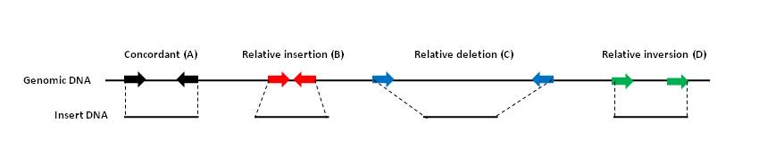
Single-End vs Paired-End Sequencing: DNA-seq
Paired end sequencing is optimal for DNA-seq
Easier mapping to reference
Essential for de-novo assembly
Essential for identifying structural changes in the genome

Slide 16
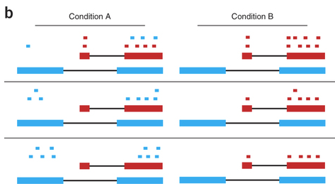
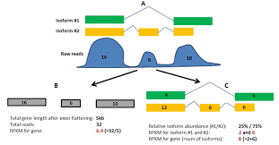
Single-End vs Paired-End Sequencing: RNA-seq
Single-end vs paired-end
To measure overall levels of RNA, single end is usually sufficient
Paired-end is preferred if interested in alternative splicing, isoform-level information

Slide 17
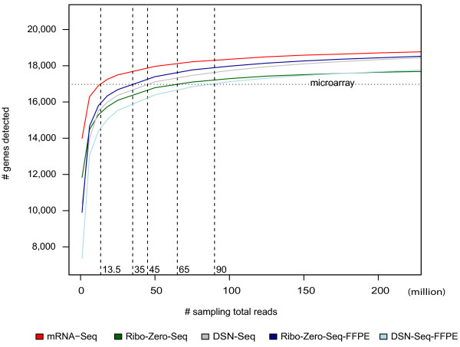
Sequencing coverage: RNA-seq
Determined empirically
Transcriptome size varies between cell types
and across organisms
Human/mouse/Rat:
mRNA → ~15M reads
mRNA +lncRNA → 30-40M reads
miRNA → 1-10M reads

Slide 18
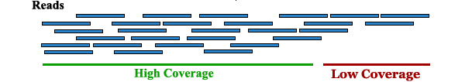
Sequencing coverage: How much sequencing do I need?
Sequencing coverage: the average number of reads covering any given base in a dataset

Slide 19
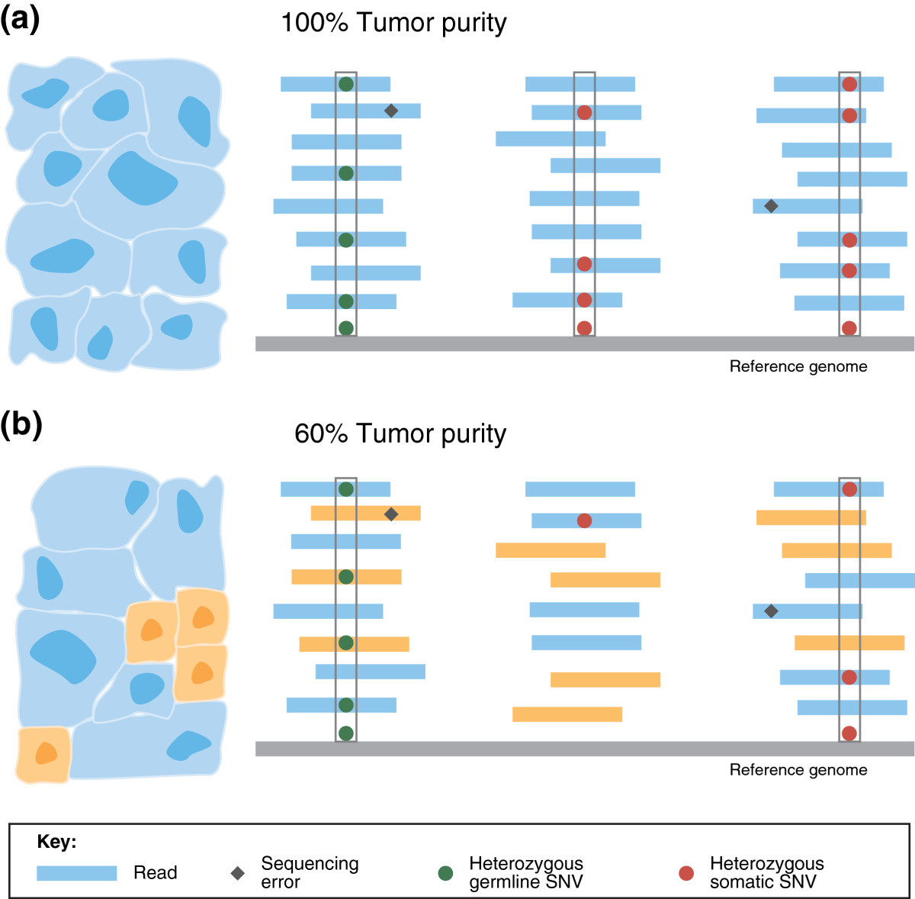
Sequencing coverage: DNA-seq
Germline
Somatic

Slide 20
Sequencing coverage: DNA-seq
What types of alternations am I looking for?
Copy Number Variation (CNV)
Low coverage OK, lower coverage = lower resolution
Single Nucleotide Variants (SNVs)
Germline
Less coverage required (20-50x)
Somatic
Depends on allele frequency (100-200x typical)
Germline
Somatic

Slide 21
I can sequence the whole genome/transcriptome, should I?
Whole Genome Sequencing (WGS)
Provides comprehensive view of the genome →Do I need all of this information?
Do I only care about changes in protein coding genes? Regulatory information important?
Expensive
Can I handle this much data?
Targeted sequencing
Whole Exome Sequencing
Enrich and sequencing only protein-coding regions of the genome (i.e. exome)
Disease-specific or custom panels
Are there specific genes/mutations I am interested in?
Do I need high coverage? (i.e. rare SNVs)
Focus sequencing efforts where needed

Slide 22
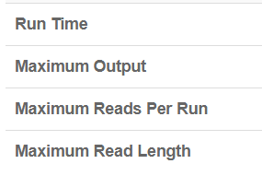
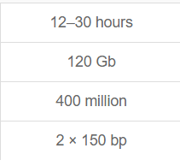
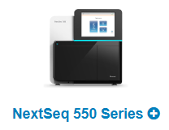
Cost considerations in WGS vs targeted sequencing
Cost = $5,500/run
Sequencing read depth = ([Coverage] * [genome/panel size]*[1+duplication rate])/[read length(bp)]
235M reads = ([20x] * [3.2Gb] * [1.1]) / [300bp] → ~2 whole genomes/run
31M reads = ([200x] * [42Mb] * [1.1] / [300bp] → 13 whole exomes / run

Slide 23
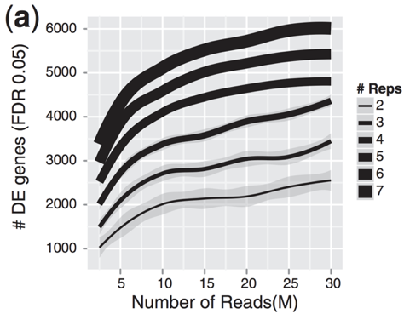
Targeted sequencing allows more replicates for better experimental design
By focusing on targets of interest, sequencing costs are reduced
Resources can be redirected towards additional biological replicates
Replicates increase ability to detect differentially expressed genes

Slide 24
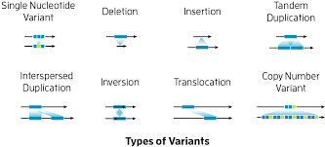
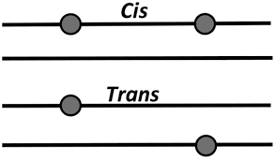
Disadvantages of short-read sequencing
Challenging to detect large-scale structural variation
Inversion, non-reciprocal translocations, duplication
Hard to map reads to repetitive regions
Telomeres, centromeres and others
Hard to map reads to genes with closely related paralogs or pseudogenes
There are over 100s of clinically actionable variants that are missed by short read sequencing because reads cannot be confidently mapped
Unable to determine for many genes, whether two mutations occur in cis or trans
Requires haplotype “phasing”

Slide 25
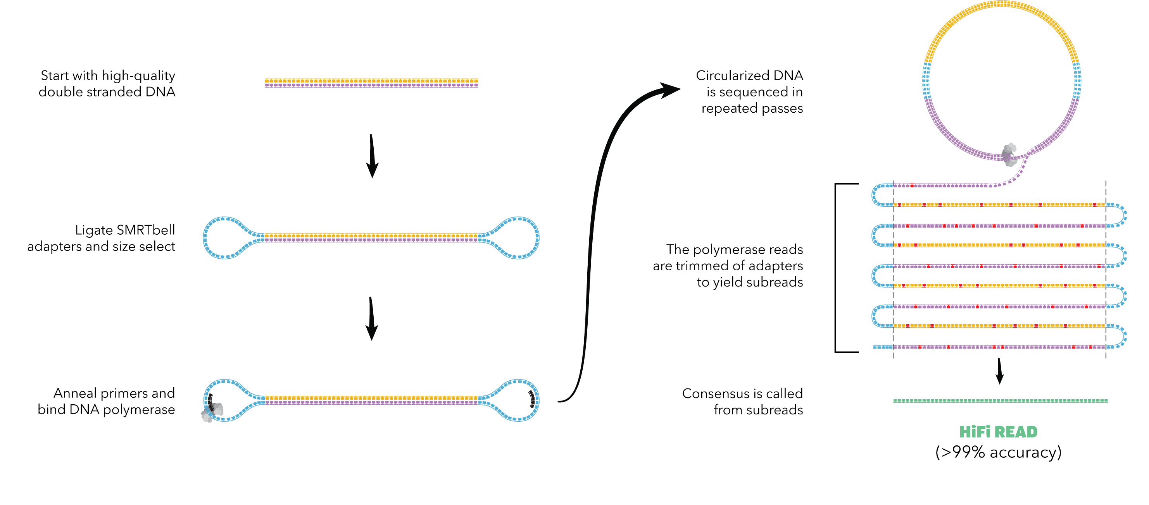
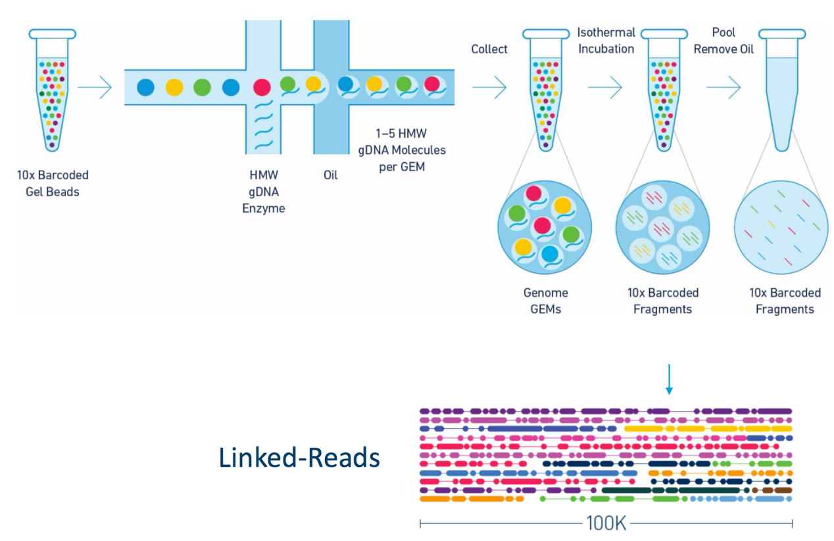
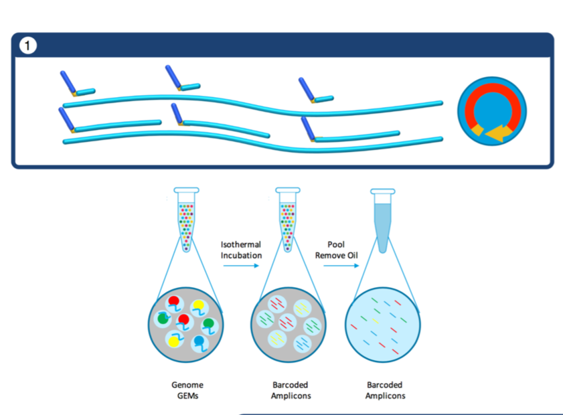
Long-read sequencing complements short-reads
Long Read Sequencing
(PacBio)
Synthetic Long-Reads
(Linked Reads)

Slide 26
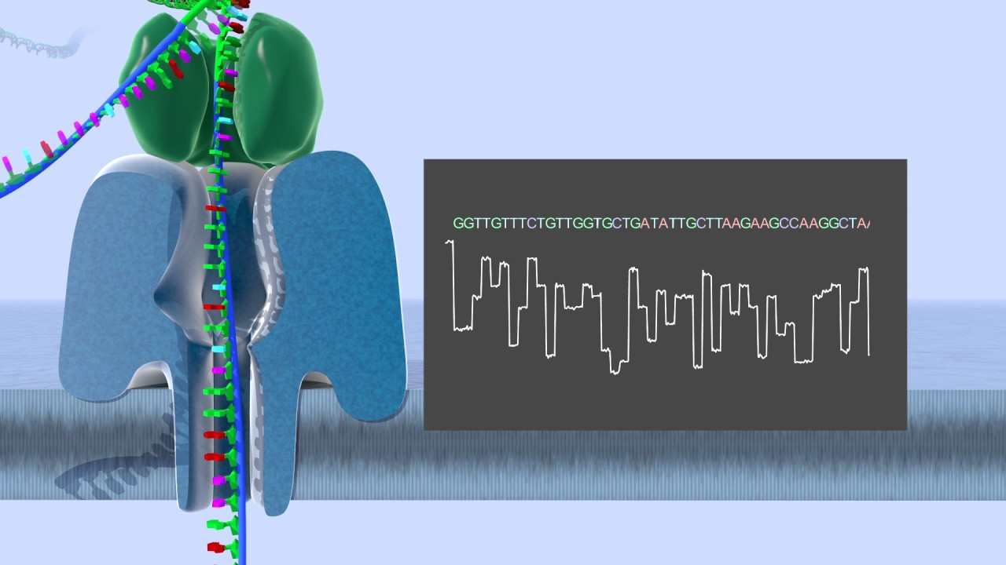
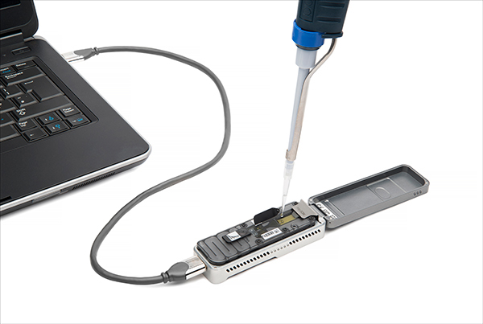
3rd generation sequencing: direct sequencing using nanopores
Advantages
VERY long reads → as long as the molecule you put in
Detection of base modifications
DNA methylation
RNA modifications
No need to convert RNA to DNA
Portable
Disadvantages
High error rate (90bp/sec, too fast to read)
Need to prepare high molecular weight DNA

